Slide 1
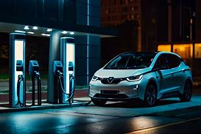
ELECTRIC VEHICLE: THE FUTURE OF MOBILITY

Slide 2
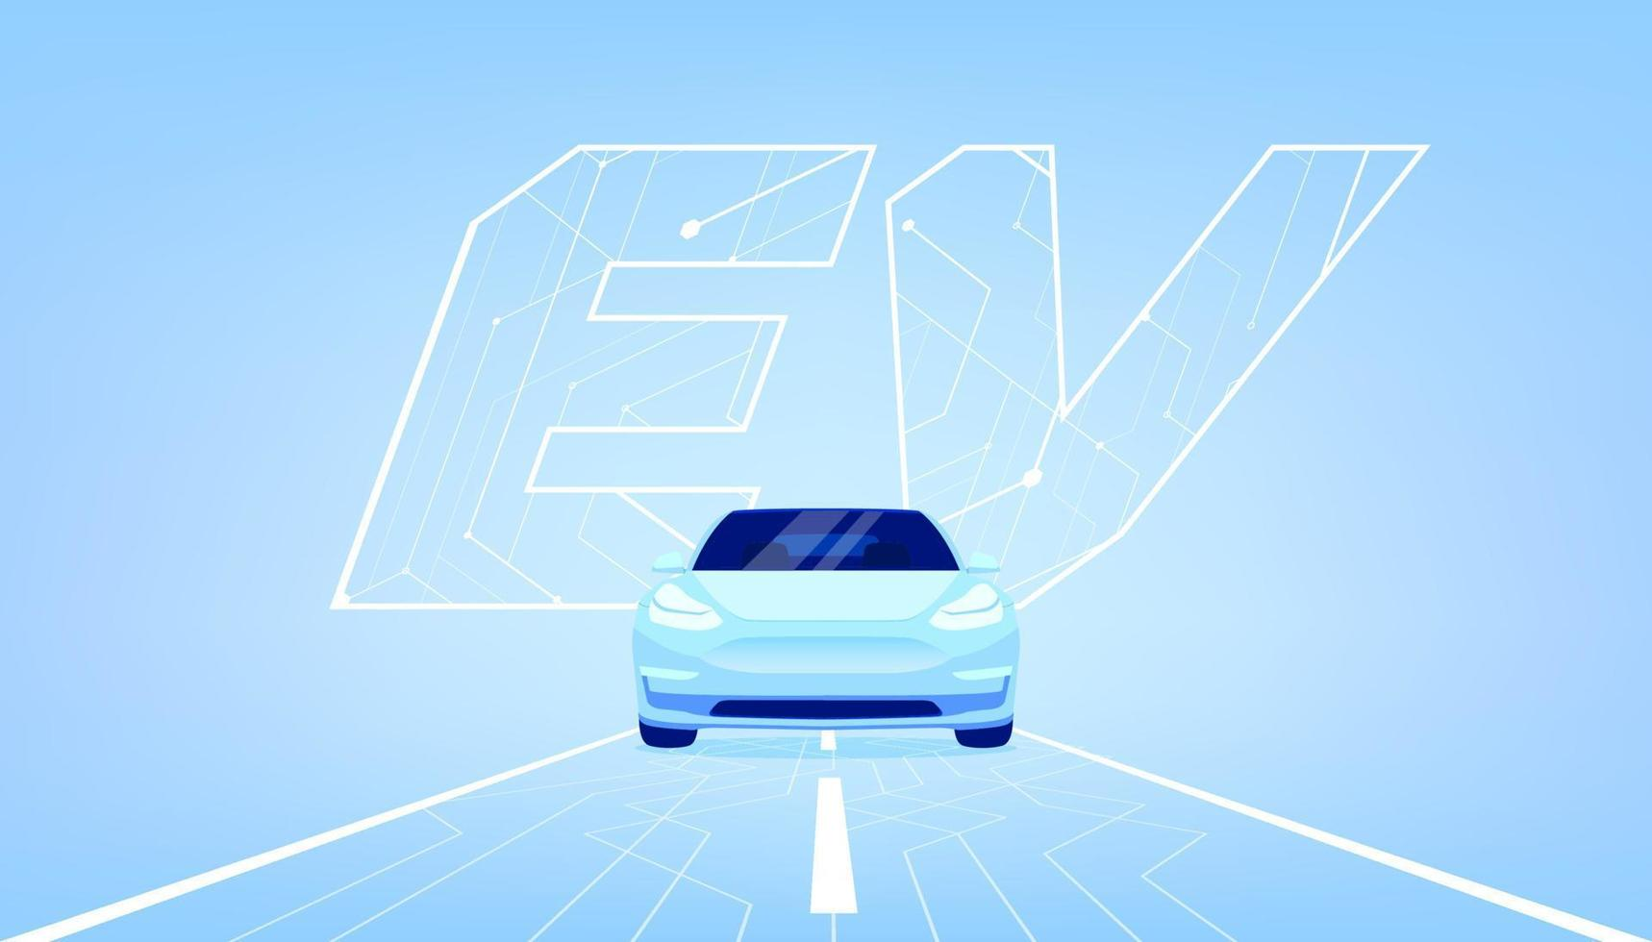
What are Electric Vehicles(EVs)?
Simply put, EV run on Electricity.
Unlike traditional cars that use
petrol or diesel ,EVs use electric motors powered by batteries.
They are cleaner, more efficient way to get around.
NO MORE FUEL TANKS , JUST BATTERIES.
These vehicles store energy in rechargeable battery packs , which are then used to power the electric motor, driving the wheels.

Slide 3
How do EVs Work? Basic Components & Function
Battery Pack
Stores DC energy for vehicle
Inverter
Converts DC to AC for the motor.
Electric Motor
Drives the wheels using AC power.
Charger Input
Supplies energy to recharge the battery.

Slide 4
Advantages of EVs
EVs produce no harmful gases (like CO2, NO2) at the point of use, improving urban air quality.
Electricity is often cheaper per mile than petrol/diesel, and prices are more stable.
The absence of engine noise and vibrations leads to a more peaceful city.

Slide 5
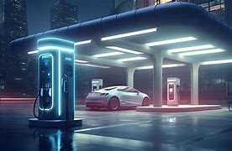
Disadvantages/Challenges of EVs
Range Anxiety : Concerns about how far an EV can travel on a single charge and the availability of charging stations.
Charging Infrastructure : Limited charging points ,especially in rural areas, can make long journeys challening.

Slide 6
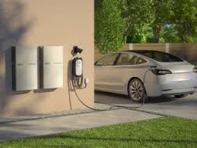
Charging your EVs
Home Charging : Most convenient option ,
Often done overnight. Can use a standard wall
Outlet charger installed at home.
Public Stations :Found at workplace, shopping
Malls, highways and dedicated charging hubs.

Slide 7
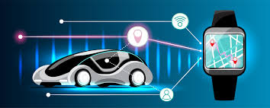
Future of EVs
Autonomous Driving & Integration
EVs are the perfect platforms for
Self-driving technology. We will
Seamless integration with smart
City infrastructure, optimizing
Traffic flow and reduce congestion.

Slide 8
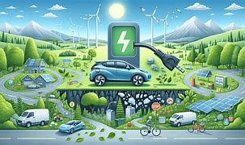
Conclusion :
Electric vehicles represent more
than just a mode of transport, they
are a significant step towards a
Sustainable and cleaner future .
While challenges remain, continuous
Innovation and growing support will
undoubtedly accelerate their adaption.

